Slide 1
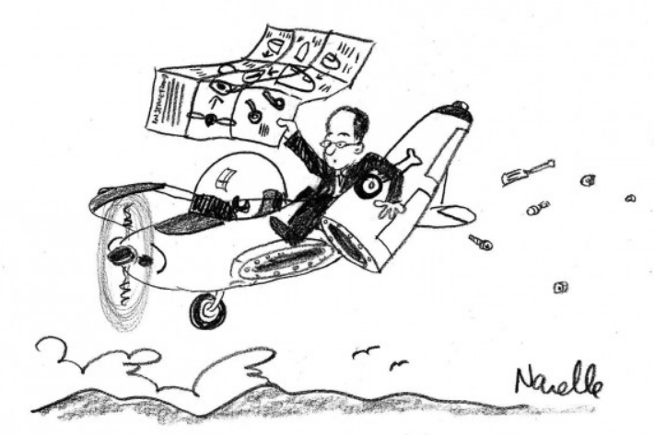
Leading CRT “Build the plane, before you fly it!”
Case Study of Visitacion Valley Middle School
Joe Truss - Principal

Slide 2
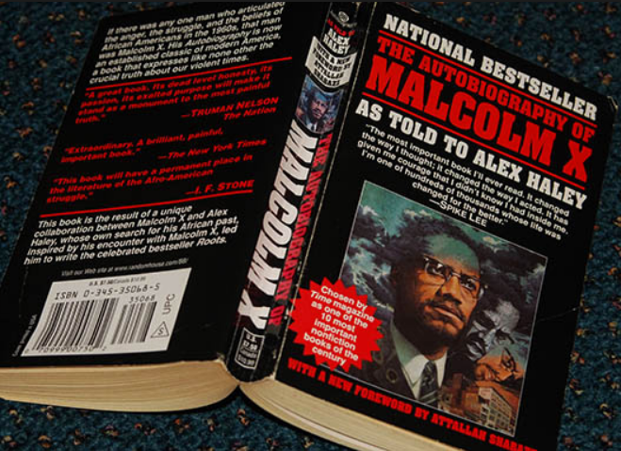
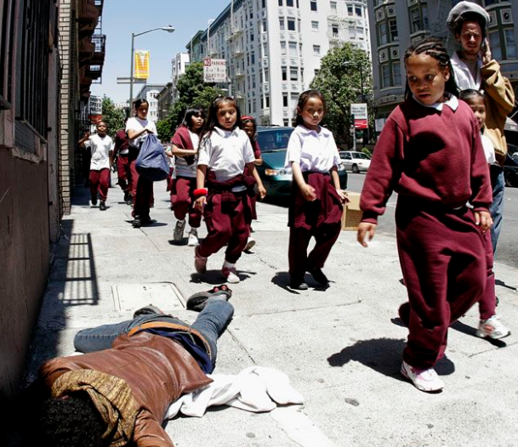
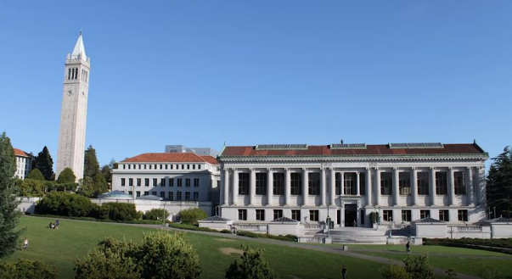
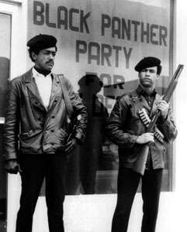
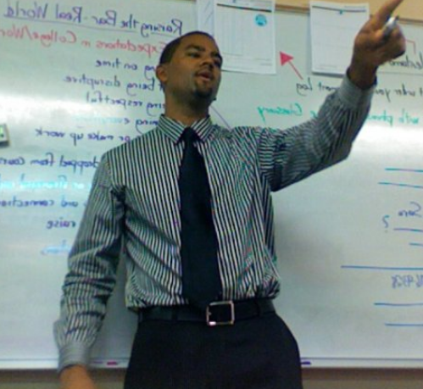
My Background

Slide 3
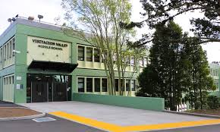
School Context
Middle School in the South East of SF
400 students, 30 teachers
Visitacion Valley (excelsior, mission, sunnydale)
Predominantly students of color
50% Latino, 15% Af Am, 25% Asian Am, 10% Filipino and Samoan
11% Performance on SBAC, 80% of students behind in reading
1000 out of class referrals (racial disproportionality)
Many vocal white teachers, mixed experience level
Lack of previous leadership vision
Focus on behavior and superficial social emotional learning
Lots of staff camaraderie

Slide 4
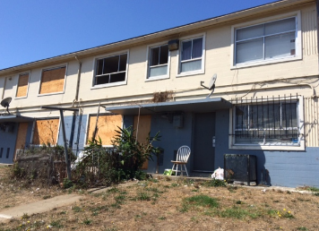
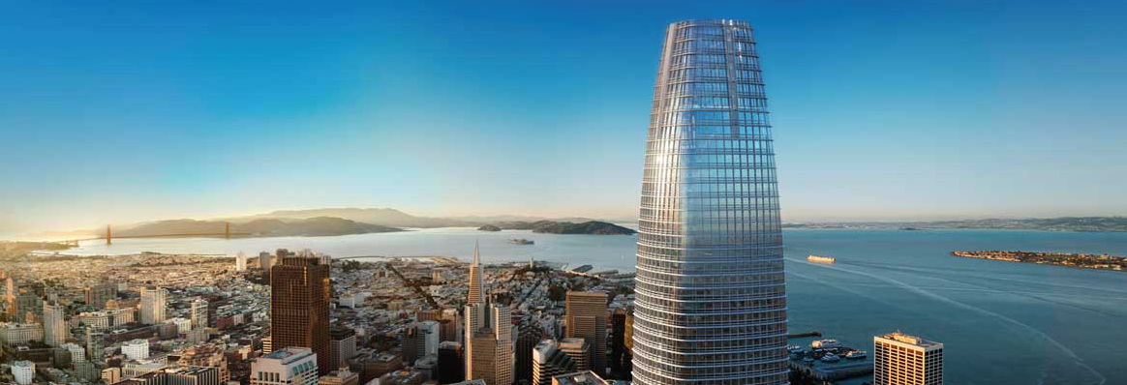
School Context

Slide 5
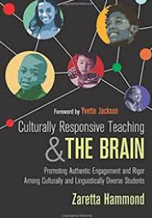
Goals for School
Raise academic achievement
Decrease disciplinary issues
Change narrative about school
Increase safety, enrollment
What was missing?
LOVE: Celebration and Joy
LITERACY: Responsive Instruction
LIBERATION: Equity Mindset

Slide 6
Quick Write (5 min)
What is missing at your school/department that is preventing you from getting to the work of providing students with Culturally Responsive Teaching?
What is in the way?

Slide 7
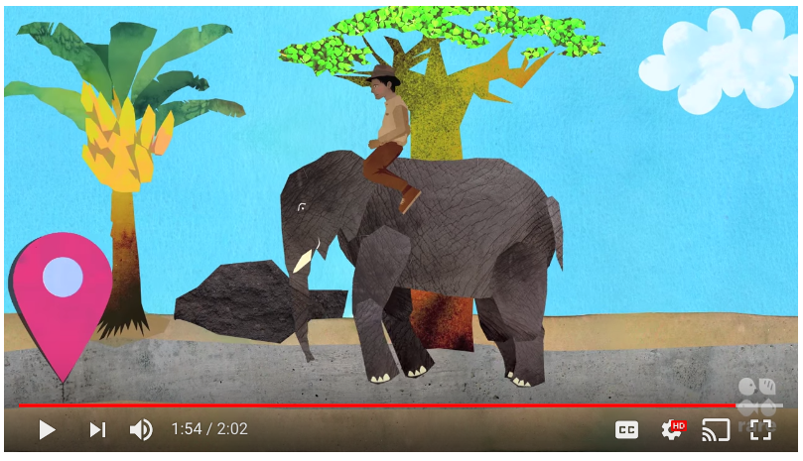
Change Management
https://www.youtube.com/watch?v=X9KP8uiGZTs

Slide 8
Our Journey Pt. 1
Summer of 2014
I read CRT and the Brain!
Fall of 2015
We read and discussed 1 chapter with our Equity leadership Team (ELT)
Spring 2016
ELT and a few others attend 2 day Seminar
We worked through Racial Equity Movement series for 3 months in Spring Semester
Admin identify CRT as a focus for the following year

Slide 9
Our Journey Pt. 1
Summer of 2014
I read CRT and the Brain!
Fall of 2015
We read and discussed 1 chapter with our Equity leadership Team (ELT)
Spring 2016
ELT and a few others attend 2 day Seminar
We worked through Racial Equity Movement series for 3 months in Spring Semester
Admin identify CRT as a focus for the following year
Summer of 2016
We purchase books or the entire staff and pre-pay them for their time to read the first half of the book
We send additional 8 staff to 2 day CRT Seminar
Fall of 2016
Partnership with Zaretta Hammond
Intro to CRT at our welcome back staff meeting
Work with ILT to discuss segments of the book
Plan weekly PD for all Staff
Zaretta trains whole staff over the course of 4 sessions spotlighting talk structures

Slide 10
Our Journey Pt. 1
Summer of 2014
I read CRT and the Brain!
Fall of 2015
We read and discussed 1 chapter with our Equity leadership Team (ELT)
Spring 2016
ELT and a few others attend 2 day Seminar
We worked through Racial Equity Movement series for 3 months in Spring Semester
Admin identify CRT as a focus for the following year
Summer of 2016
We purchase books or the entire staff and pre-pay them for their time to read the first half of the book
We send additional 8 staff to 2 day CRT Seminar
Fall of 2016
Partnership with Zaretta Hammond
Intro to CRT at our welcome back staff meeting
Work with ILT to discuss segments of the book
Plan weekly PD for all Staff
Zaretta trains whole staff over the course of 4 sessions spotlighting talk structures

Slide 11
Pair Share (5 min)
What issues do you see in the plan we rolled out?
Where might there be some potential holes?
Were there any opportunities to truly build the plane before flying it?

Slide 12
Our Journey Pt. 1
Summer of 2014
I read CRT and the Brain!
Fall of 2015
We read and discussed 1 chapter with our Equity leadership Team (ELT) (RED FLAG)
Spring 2016
ELT and a few others attend 2 day Seminar
We worked through Racial Equity Movement series for 3 months in Spring Semester (RED FLAG)
Admin identify CRT as a focus for the following year (RED FLAG)
Summer of 2016
We purchase books or the entire staff and pre-pay them for their time to read the first half of the book
We send additional 8 staff to 2 day CRT Seminar
Fall of 2016
Partnership with Zaretta Hammond
Intro to CRT at our welcome back staff meeting (RED FLAG)
Work with ILT to discuss segments of the book
Plan weekly PD for all Staff (RED FLAG)
Zaretta trains whole staff over the course of 4 sessions spotlighting talk structures

Slide 14
Missing Blueprint - Capacity
Leader:
I made it a focus before I truly understood CRT
Teacher Leader:
We pushed Lead Teachers to lead it before they wrestled with it
Teacher:
We asked teachers to implement too soon, without enough practice

Slide 16
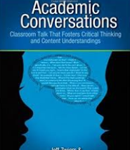
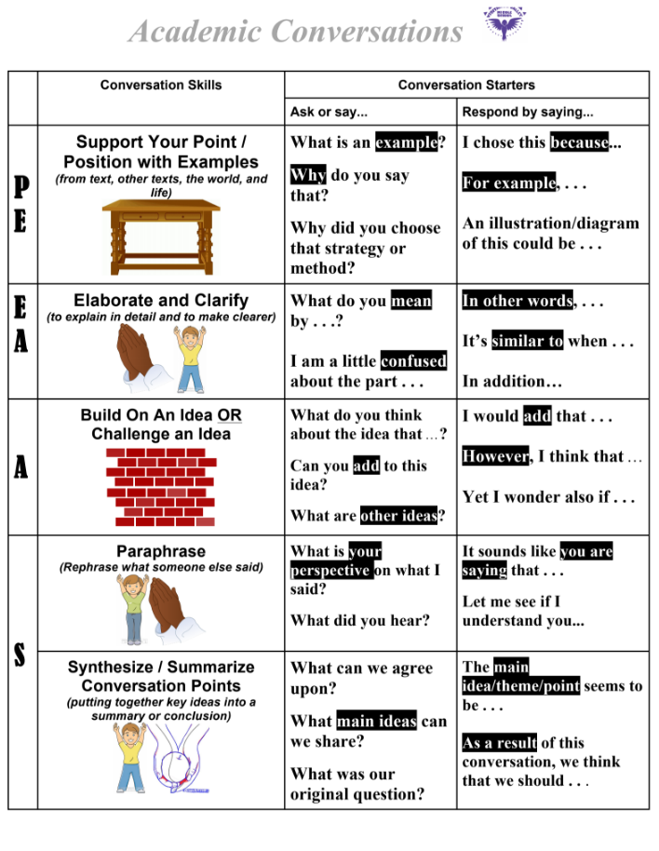
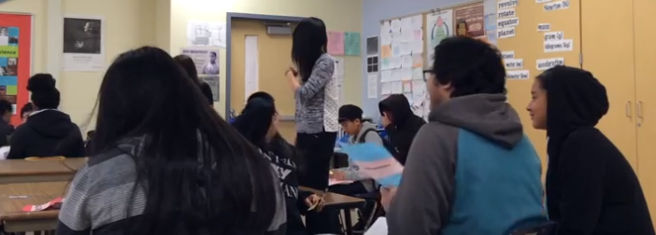
Our Journey Pt. 2
ILT gets excited about student talk and selects structured academic talk as a focus for the Spring semester
ILT pilots work, observes each other and invites greater staff to observe them
School-wide Spring semester focus on talk structures, posters, teachers pick focal skill
Teachers observe Lead Teachers
Instructional Rounds focused on Academic Talk
End of the year Teacher showcase where some departments present their reflections on using Structured Academic Talk and CRT throughout the year

Slide 17
Conditions for Leading CRT (and any big change initiative)
Mindset
Timeset
Capacity
Leader
Teacher Leaders
Teachers
Adult Culture

Slide 18
Missing Blueprint - Timeset
85 Minute PDs
Morning meetings
Once per month
Every other month

Slide 19
Staff Quotes
“We want to practice this.”
“Ok, so what exactly is CRT”
“We want strategies” “What can I use tomorrow?”
“We are already doing that”
“It’s all about relationships right?”
“I'm uncomfortable giving up the control”
“We keep doing something different every month.”
“I don’t feel comfortable leading this.”
“When do I find time to do this in the class period?”
“What I have been doing is working.”

Slide 20
Staff Quotes | Conditions
“We want to practice this.” | Capacity, Timeset – Path
“Ok, so what exactly is CRT” | Capacity - Path
“We want strategies” “What can I use tomorrow?” | Capacity – Path Mindset – Emotion
“We are already doing that” | Mindset – Emotion Adult Culture – Path, Direction
“It’s all about relationships right?” | Mindset - Emotion
“I'm uncomfortable giving up the control” | Mindset – Emotion Capacity - Path
“We keep doing something different every month.” | Leader Capacity - Path
“I don’t feel comfortable leading this.” | Teacher Leader Capacity – Path
“When do I find time to do this in the class period?” | Timeset – Path
“What I have been doing is working.” | Mindset - Emotion

Slide 21
Where are we now?
We connected CRT to the use of language objectives for English Language Learners
Connected CRT to trauma-sensitive practices
We model CRT in our staff meetings
We redesigned our bell schedule to allow for deeper learning and longer common planning time (2 hour meetings)
We spend more time on equity framing, reflecting on our discourse, and revisiting our data
More teachers use talk structure in their classes
We are doing PBL whole school next year, using CRT as a framework

Slide 22
Reflections and Conclusions
You have to start somewhere. Determine which condition is needed and plan it out.
Some people have to see it in action before they will believe it, those folks need "strategies" and need to implement them with fidelity. CAPACITY/PATH
Some people need to believe it before they can see it, those folks need data, theory, research, and their heart string pulled MINDSET/EMOTION
It not enough to spend 1 PD session or even a full day on CRT. It must be year long and multi-year plan.

